Slide 1

REAL LIFE LAB(RLL) GROUP- IV

Slide 2

INSURANCE POLICY MANAGEMENT

Slide 3

Team Lead : Members :
Ashwani Sharma
Ramyabharathi Marimuthu
Gowsika Ramesh
Pargati X
Abiram Venkatachalam
Karan Kaushal
Janesh M K
Ashutosh Kumar Pandey
Atla Praveen Kumar Reddy

Slide 4
CONTENT
Project Overview
Objective
Tools and technologies
Project Requirements
Implementation
Insurance policy flow-chart
Modules
Advantages
Future scope

Slide 5

PROJECT OVERVIEW
Create a dynamic and responsive web application for managing the insurance policies application online.

Slide 6
OBJECTIVES
To provide a bug-free application to the policy maker (Admin) as well as the customer,
The main objective is to build a secured, robust insurance management system where the policies are managed properly.
It maintains the record of customers, policies, buyers policies efficiently so that it would be easy to access at any time 24*7.

Slide 7
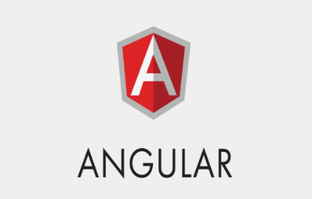


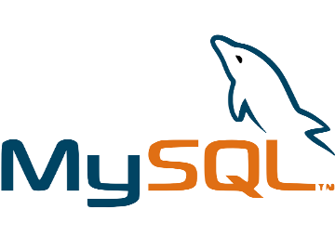

TOOLS AND TECHNOLOGIES
Backend : JPA, Java, Springboot
Frontend : Angular, HTML, Boostrap, CSS
Server : Tomcat
Database : MySql
Testing :TestNG

Slide 8
PROJECT REQUIREMENTS
EclipseIDE: To handle backend.
JDK : To run this project you have above 1.8 version.
Tomcat 9: This project runs over tomcat 9 server.
MYSQL : You need MYSQL database for running this project.
MYSQL J Connector : For making the connection from MYSQL and Java, we need it.
Angular CLI : For running the angular project for frontend.
SpringBoot : For running the springboot project for backend.

Slide 9
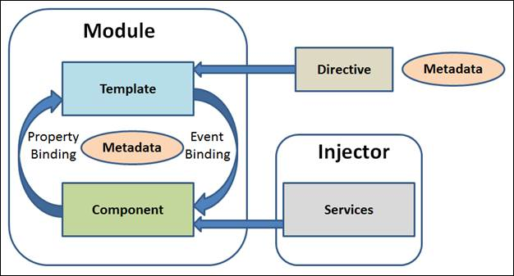
ANGULAR IMPLEMENTATION
Angular is used to develop the frontend application. It is an open-source, JavaScript framework written in TypeScript. Google maintains it, and its primary purpose is to develop single-page applications. As a framework, Angular has clear advantages while also providing a standard structure for developers to work with.

Slide 10
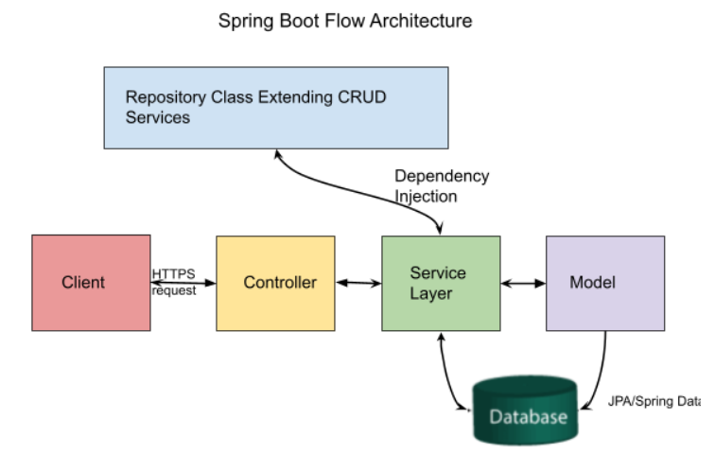
SPRINGBOOT IMPLEMENTATION
Springboot is used perform the backend application. It is used to develop the API and operations like add, update, delete and view and connecting to MYSQL database.

Slide 11
INSURANCE POLICY –FLOW CHART
HOMEPAGE
Customer
Admin
About us
Contact us
Registration Page
Login Page
User Dashboard
Login Page
Admin Dashboard
Questions
Home
Policies
Create Account
Logout
User Applied Policies
Home
Available Policies
Status
Q/A Part
Add policy
Update policy
View policy
Delete policy
Apply
View All Policy

Slide 12
Modules
Admin Module
Customer Module
Testing Module
Q & A Module
Customer Policy Dashboard
Admin Policy dashboard

Slide 13
ADVANTAGES
Improved Efficiency:-Instead of dealing with paper, you will transition to electronic documents that let you organize data in the best way. In the end, your employees and customers will be grateful.
Enhanced Customer Service:-With policy management software expanding to mobile devices, you will be able to provide customers with timely responses, thus contributing to increased satisfaction.
Automated Regulatory Compliance:-Improved compliance monitoring will help minimize breaches that are likely to incur financial costs.

Slide 14
FUTURE SCOPE
Similar to many other services, online insurance in India is also getting famous and is benefitting a number of people.
With the increase in number of internet users it has also been noticed that the number of people taking up insurance policies online has also increased.
There was a time when people with high salaries believed in getting insurance policies and that too, mainly, life insurance policies.
But today an individual who has just joined a job starts buying insurance.
It might be safe to presume that online is the future for the Indian insurance industry .

Slide 15
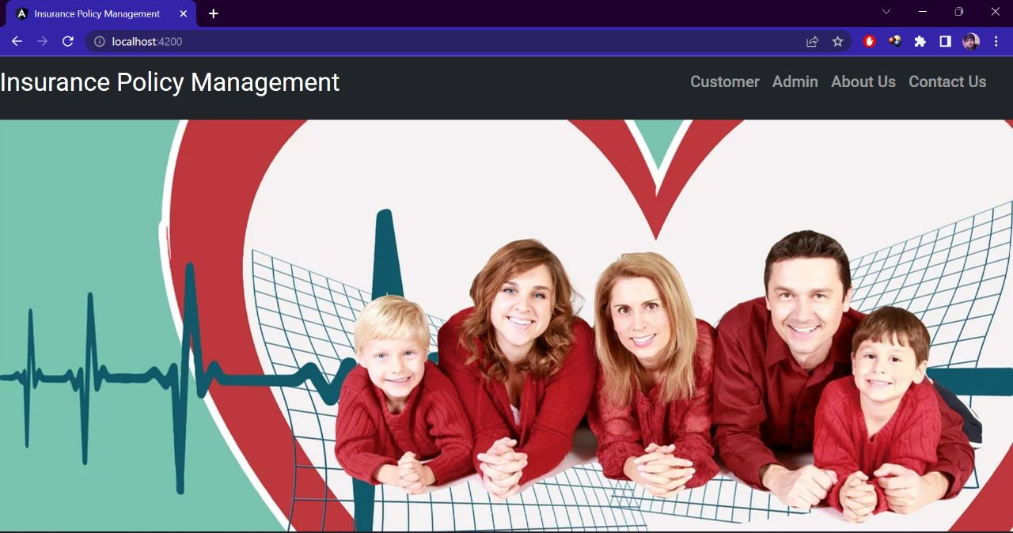
Home Page

Slide 16
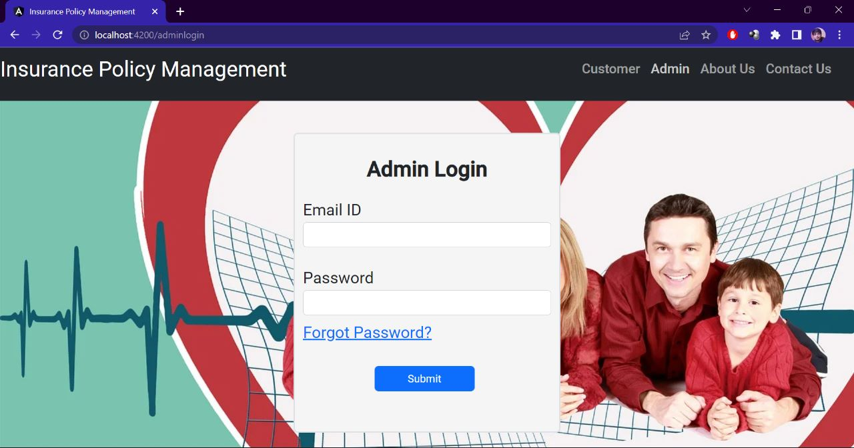
Admin Login

Slide 17
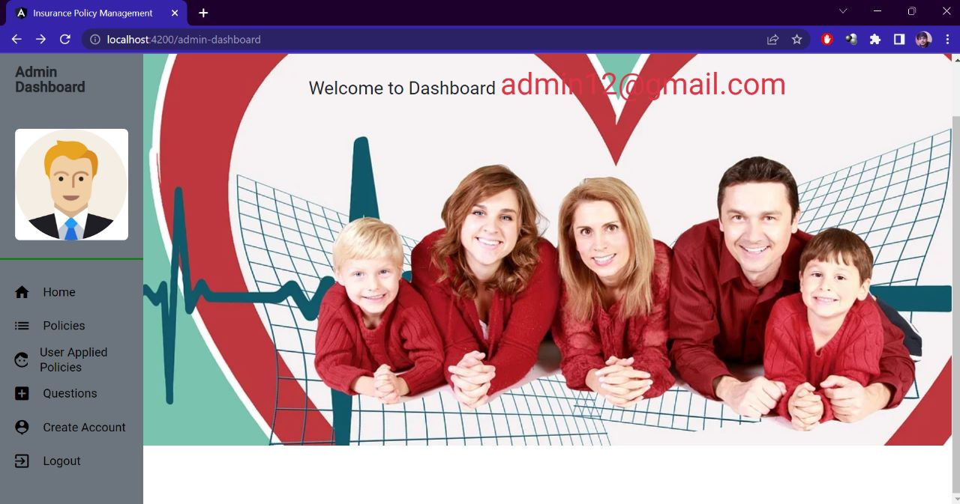
Admin Dashboard

Slide 18
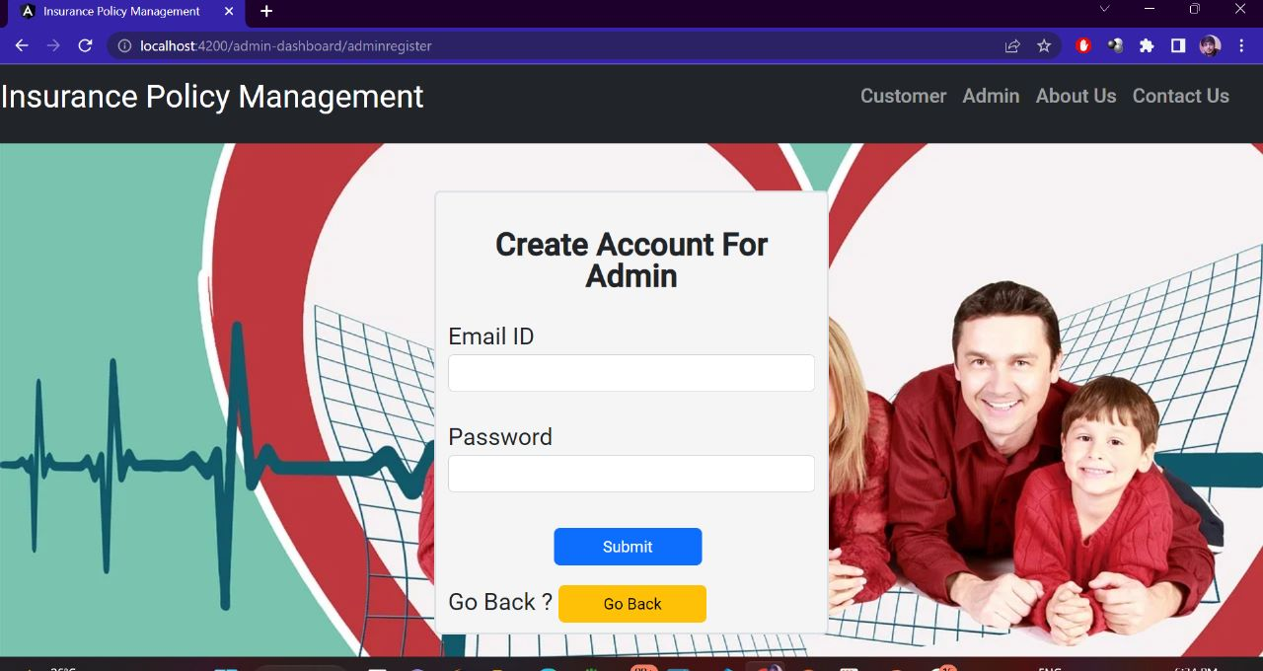
Create Account for Admin

Slide 19
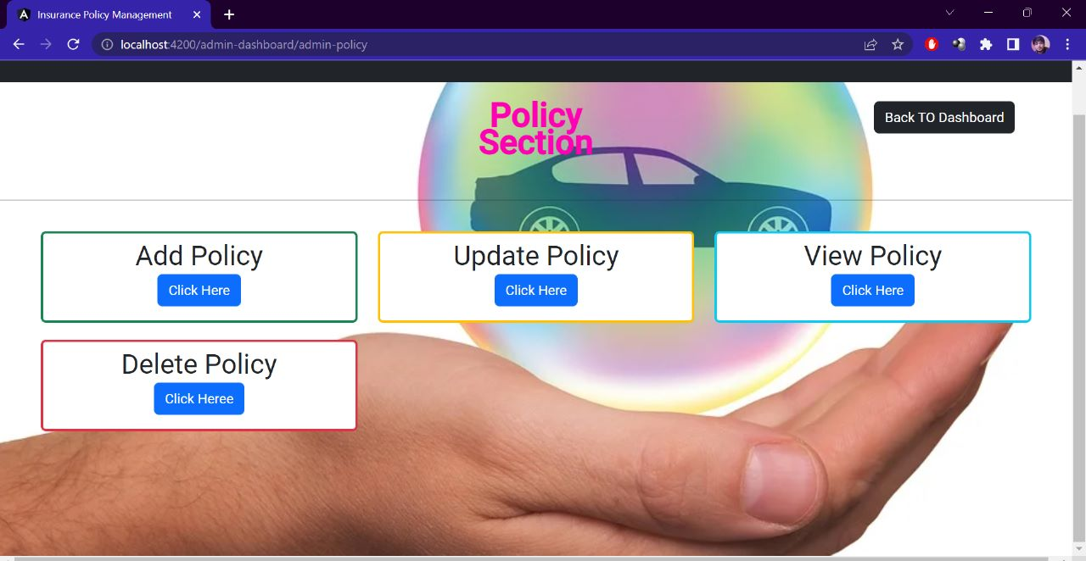
Policies

Slide 20
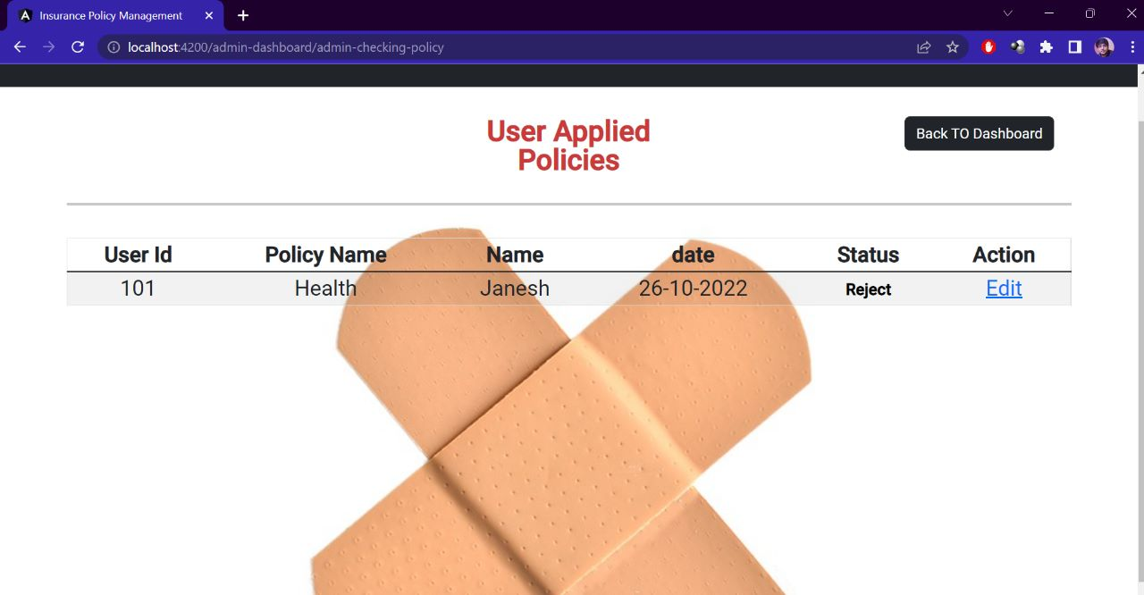
User Applied Policies

Slide 21
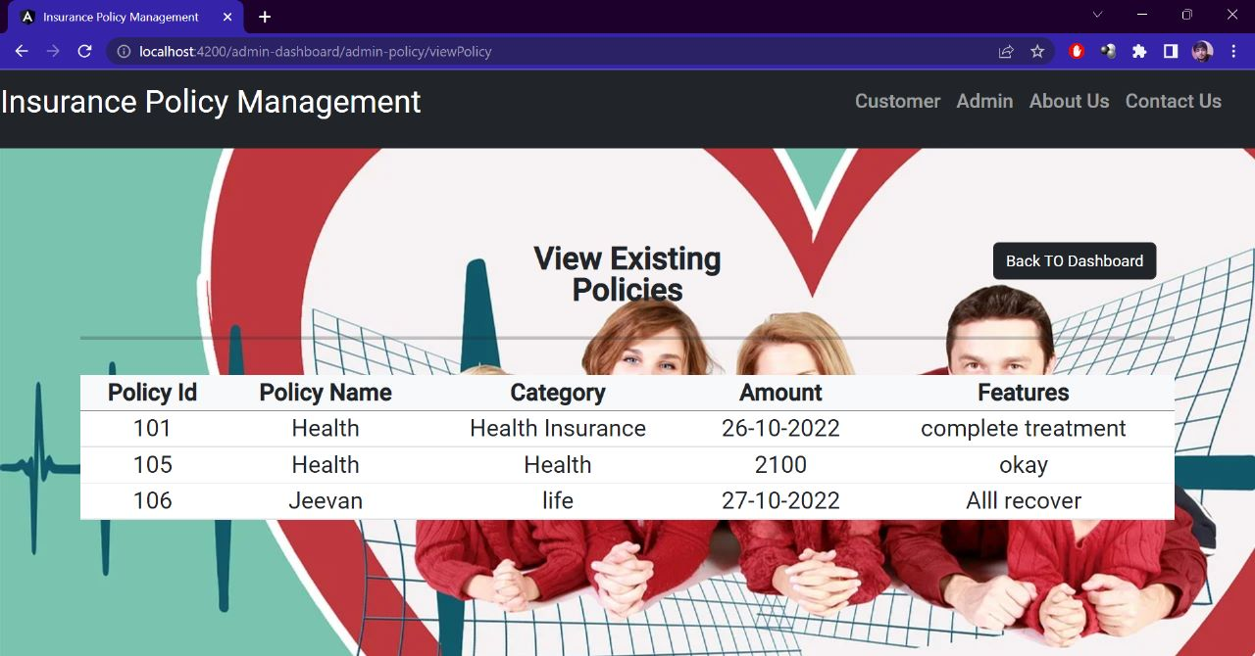
View Existing Policies

Slide 22
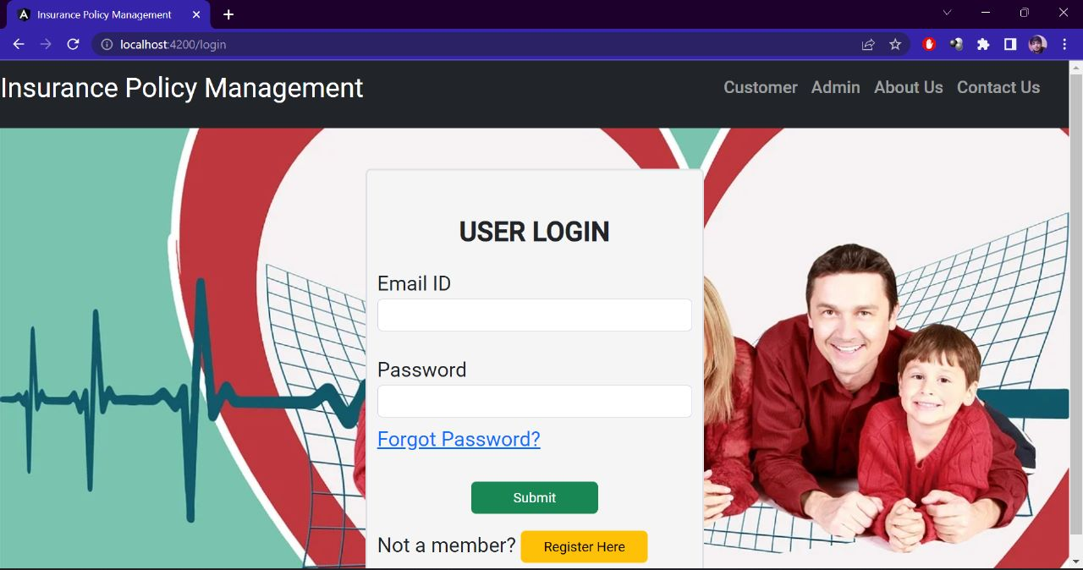
User Login

Slide 23
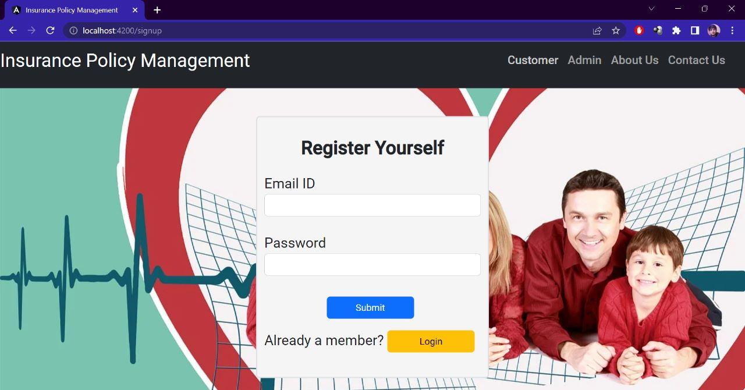
Registration Page

Slide 24
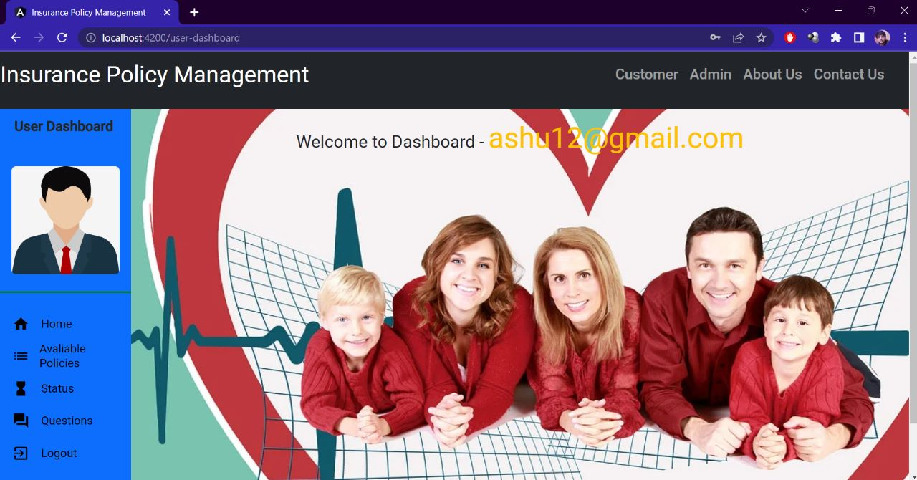
User Dashboard

Slide 25
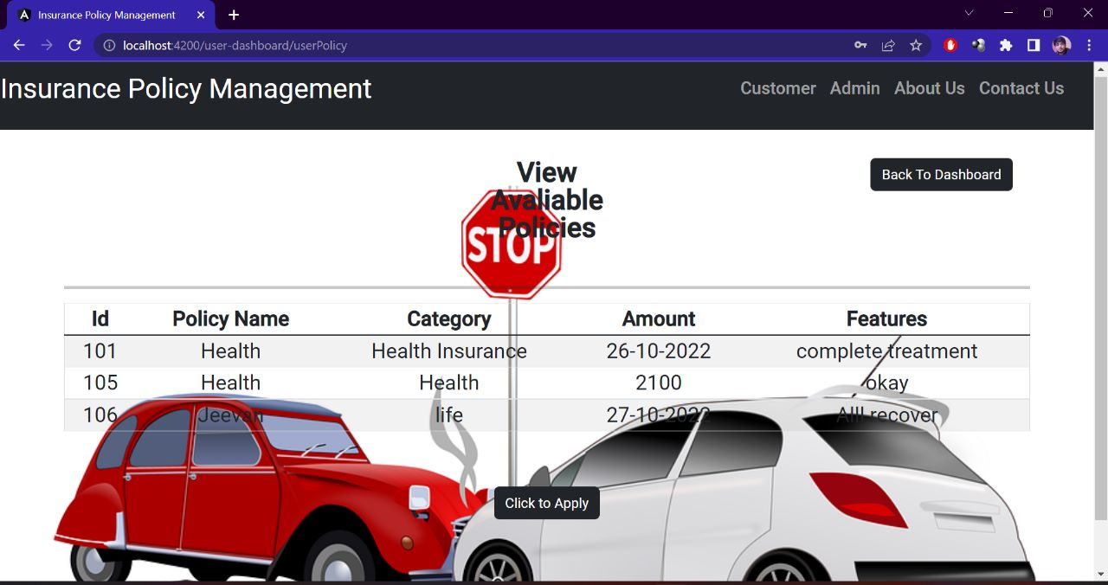
View Available Policies

Slide 26
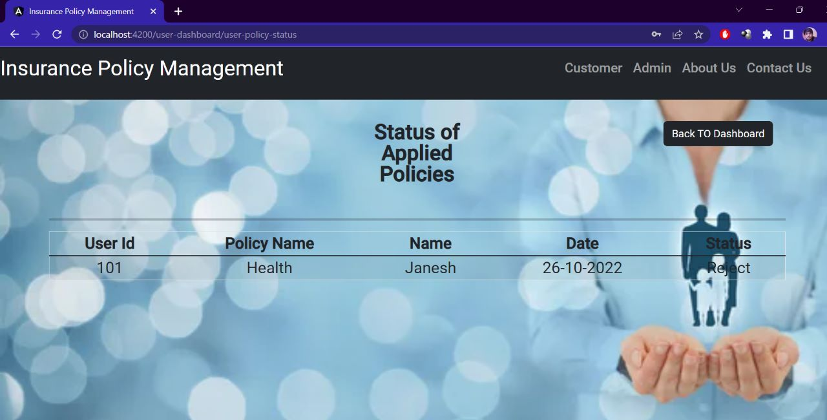
Status of Applied Policies

Slide 27
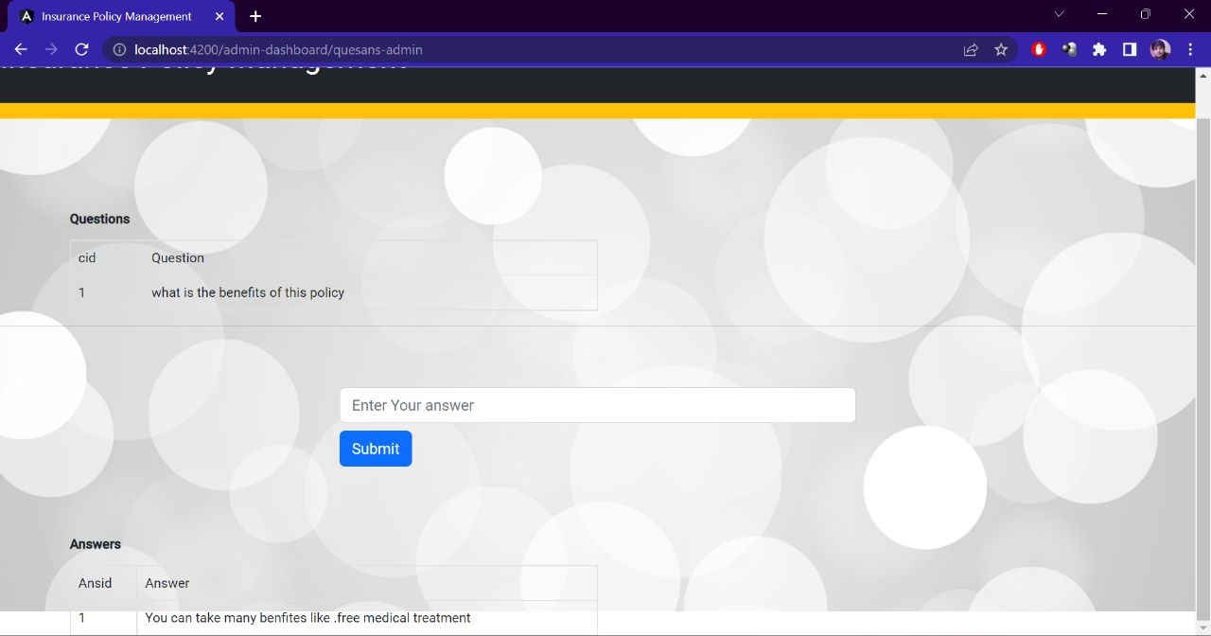
Questions

Slide 28
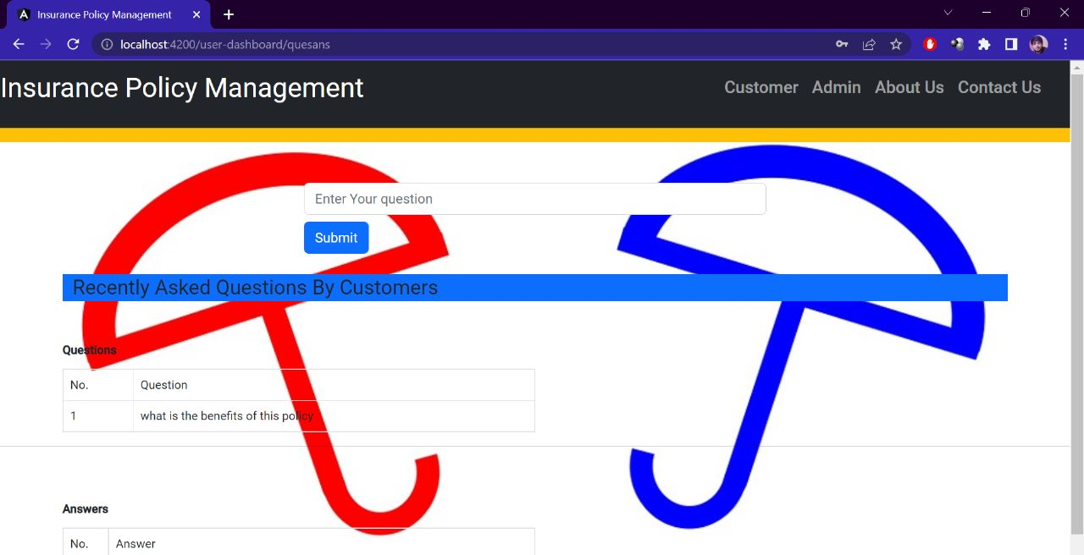
Questions

Slide 29
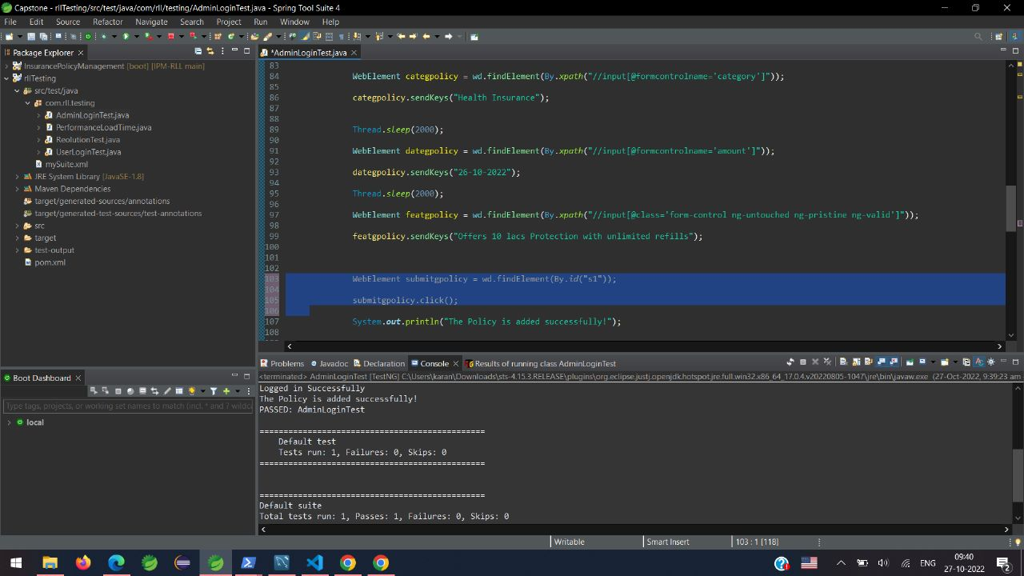
Testing

Slide 30
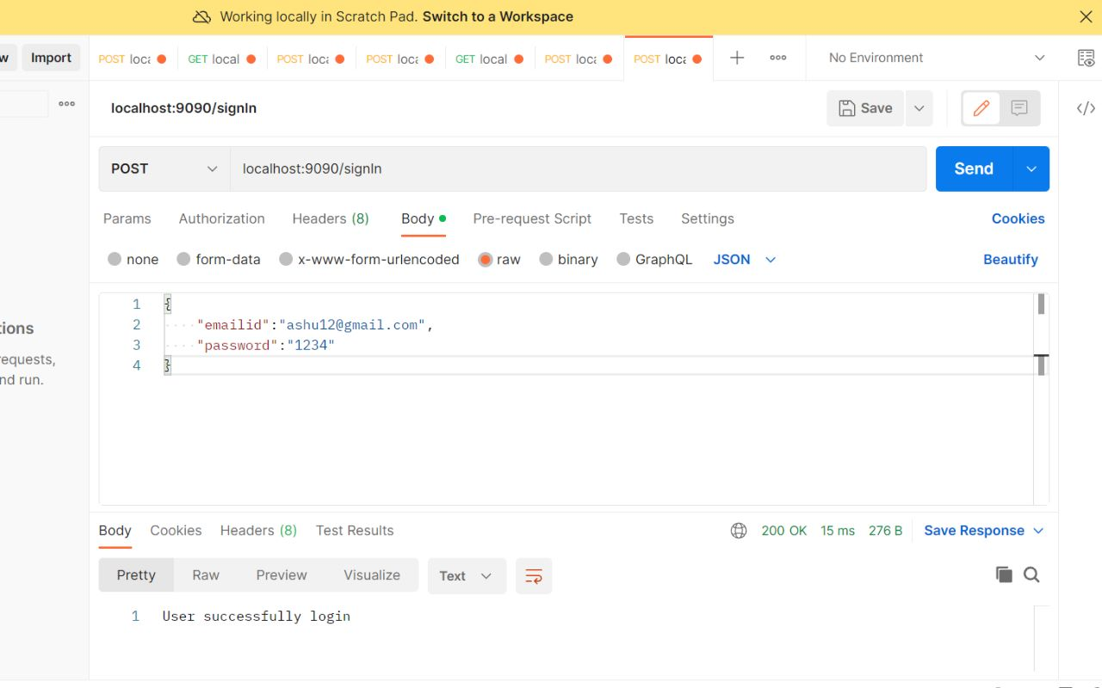
Postman Testing

Slide 31


